Slide 1
Extend Kubernetes Using Rust:
A Quick Introduction to kube-rs
Yannik Dällenbach
Rust Talks Bern, 20.02.2025

Slide 2
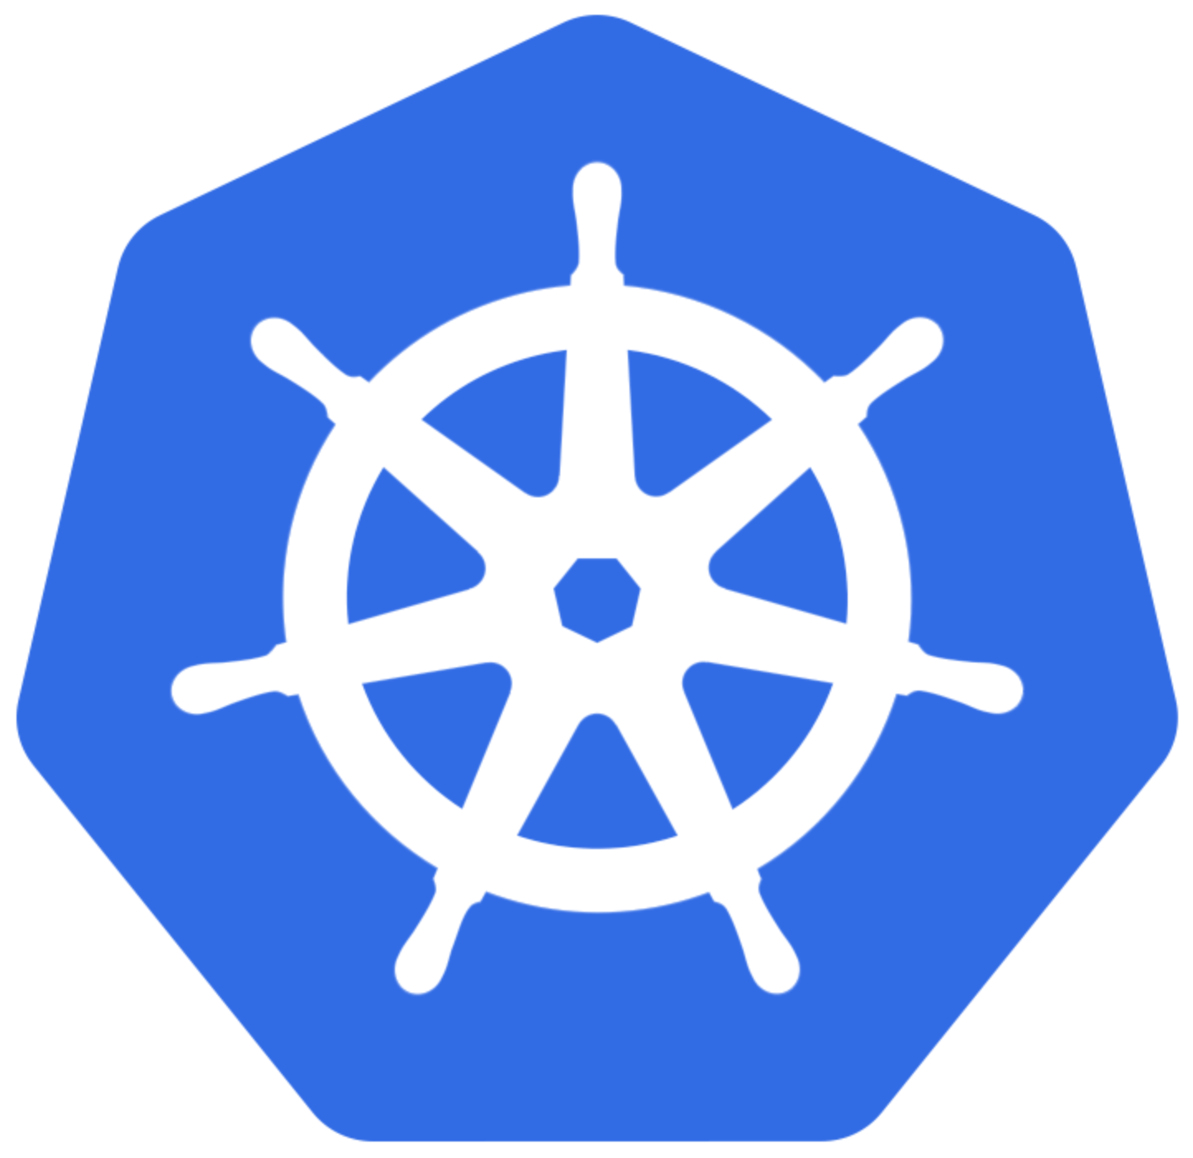

Agenda
Introduction to Kubernetes
kube-rs
Demos
💕

Slide 3
What Is Kubernetes?
Kubernetes is a portable, extensible, open source platform for managing containerized workloads and services, that facilitates both declarative configuration and automation.
https://kubernetes.io/docs/concepts/overview/

Slide 4
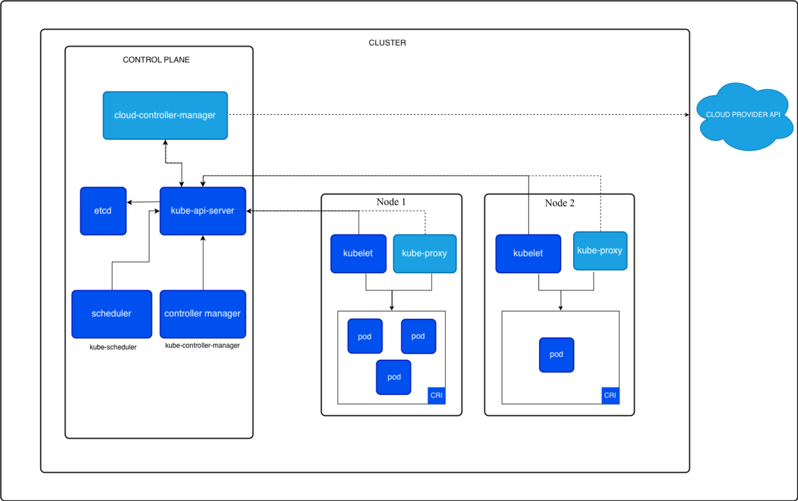
https://kubernetes.io/images/docs/kubernetes-cluster-architecture.svg

Slide 5
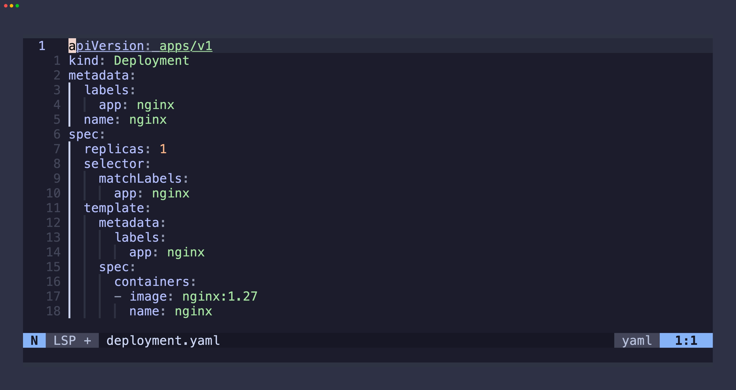
Kubernetes API
Resources (Pods, Deployments, Services, etc.)
Controllers and Operators
Custom Resource Definitions (CRDs) allow extending the API

Slide 6
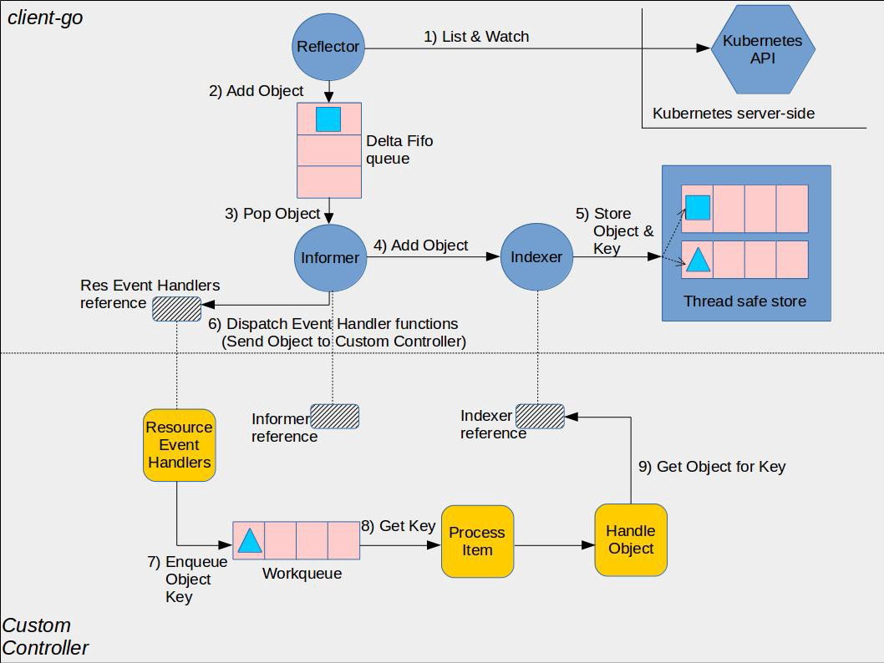
https://github.com/kubernetes/sample-controller/blob/master/docs/images/client-go-controller-interaction.jpeg

Slide 7
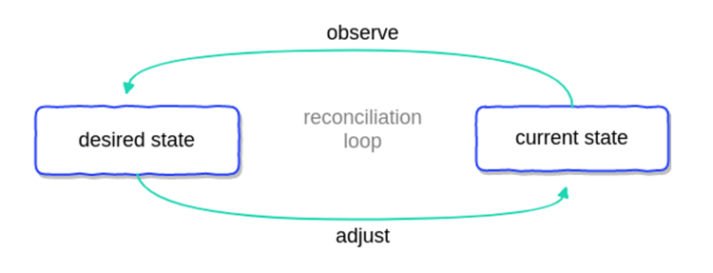
https://github.com/kubernetes/sample-controller/blob/master/docs/images/client-go-controller-interaction.jpeg
https://blog.container-solutions.com/hs-fs/hubfs/kubernetes_operators_diagram1.png

Slide 8

kube-rs
Rust client for Kubernetes
Runtime abstraction
Derive macro for CRDs
First release: April 29, 2019
Hosted by CNCF as a Sandbox Project
since November 16, 2022

Slide 9
kube-rs: Runtime
watcher: stream of events
reflector: watcher + store
controller: reflector + n watchers + reconciler

Slide 10
Demos

Slide 11
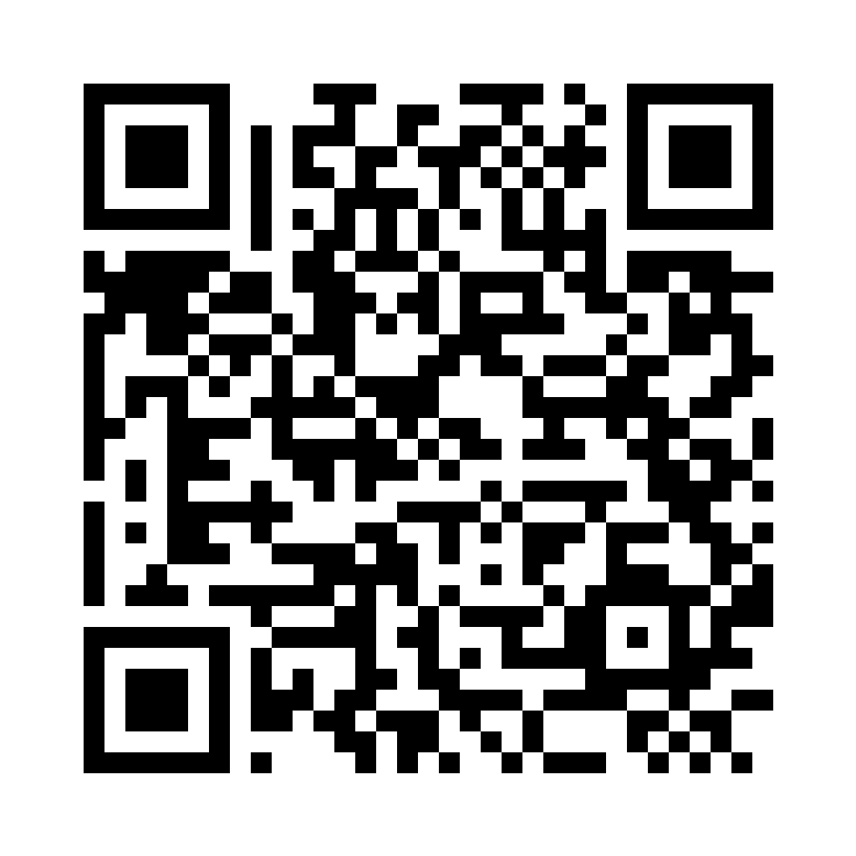

Resources
https://kube.rs/
https://github.com/kube-rs/version-rs
https://github.com/kube-rs/controller-rs
https://github.com/kube-rs/kube/issues/584
https://github.com/olix0r/kubert
https://ahmet.im/blog/controller-pitfalls/
https://github.com/linkerd/linkerd2/tree/582f1afa5ebf0f3d227a0260bc611e987fcd261e/policy-controller

